Slide 1

Problem
Significance
Solution
Evaluation
Prediction under Changing Distributions
Reporter: Yiliao Song
Centre for Artificial Intelligence
Faculty of Engineering and Information Technology University of Technology Sydney (UTS)
Notes:
Hello, everyone. My name is Yiliao Song.
Today I’m very happy to share something about my research with you.
My research topic is to predict under changing distributions and
In this report, I will explain what is the problem, why this problem is important, one of my proposed solutions to this problem and the experimental evaluation of the proposed solution.

Slide 2
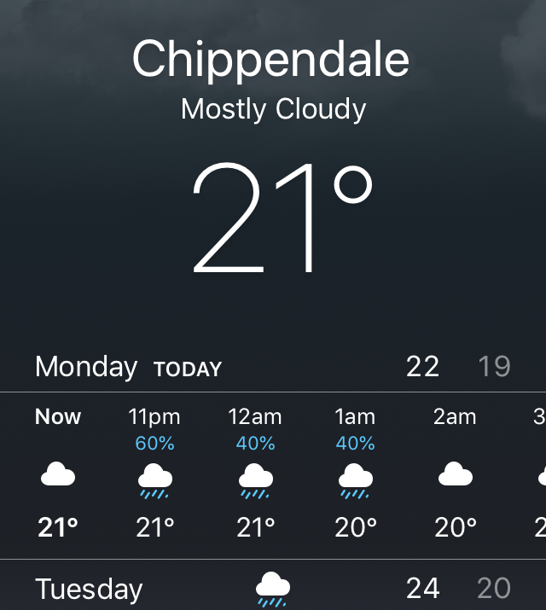



Prediction Tasks
Problem
Problem
Notes:
I think most of you here are very familiar to the Prediction task. Prediction has many mature applications in our daily life.
For example, the email filtering system helps us to block spams, which is to predict the discrete label of “Spam” or “Not Spam”.
And weather forecast is to predict the atmospheric factors which is a continuous label

Slide 3
Prediction by Machine Learning
Machine learning is a computational process of discovering patterns from historical information
The overall goal of machine learning is to extract useful information from data and transform it into an understandable structure (knowledge) for further use.
Same data distribution
Training
Training data
Trained model
Apply
New data need to predict
(testing data)
Predicted label
A basic assumption of machine learning is historical data and the new data have the same distribution
Problem
Notes:
There are many ways to predict labels, such as partial differential equations and dynamic Systems, . But today I’m going to talk about how to predict by machine learning methods.
Here is the process. Machine learning methods trains a model from the training data that contains both the attributes and the desired labels.
Once the model is trained, it will be applied to predict the label of a new data instance that only contains attributes.
There are many existing machine learning methods use this train-and-test process to solve prediction problems.
(Click)However, few of them have realized that a basic assumption of why such process is effective is that the training data and testing data have the same data distribution.
One of main reason that the conventional machine learning methods can still achieve good prediction results is because their prediction tasks are based a stationary setting. Once the prediction is in a dynamic setting, the identical distribution assumption may be broken and the conventional machine learning methods will be invalid.

Slide 4
Data Streams with Evolving Data Distribution
Stationary setting in data sets
Training set:
Observations from the population
observe
learn
One targeted population
following a specific pattern
Prediction boundary
Dynamic setting in data streams (Concept drift)
time
…
A sample of population following pattern 1
(Concept 1)
…
Concept 2
Concept 3
Problem
Notes:
This is the difference between a stationary setting and dynamic setting.
In the stationary setting, this is our targeted population, and we want to learn the pattern of this population, namely, the boundary between blue dots and red dots.
Normally, we cannot get all data from this population or don’t have to do that. but we can observe a small sample from it as is shown in the training set.
We use this small sample to learn the pattern and known that if dots in the left of this curve is blue and in the right is the red.
In contrast, in the dynamic setting, data comes as a stream. The patterns of the targeted population is changing overtime. Here we can see, in the first pattern, the number of red dots is equal to that of the blue dots, but in the second pattern, blue dots are much more that the red.
This is called concept drift. The term “concept” refers to the patterns of the data.

Slide 5








Example of Concept Drift
Time
August
Intends to buy a new car
Subscribes many car ads
September
Gets a new car
After purchase
SPAM
No more needs car ads
Problem
Notes:
Why concept drift occurs? Or why we need to consider the prediction tasks in a dynamic setting?
Here is an example.
A customer wanted to buy a new car in August, and he subscribed a lot of car ads during that time.
He finally got a fancy car at the beginning of September and he did not want to receive car ads anymore.
During these two months, the car ads are labelled as ”not spam” in August as well as ”spam” in September in Tom’s spam filtering system.
Clearly, the distribution of email context and the label that whether an email is a spam is changing during this period.

Slide 6


Challenges of Concept Drift
Concept drift problem: prediction by machine learning is invalid in data streams with evolving data distribution
Training
concept 1’s sample
Trained model
apply
concept 2’s sample needs to predict
How to precisely predict labels when data distribution is changing?
Problem→Significance
Notes:
Once concept drift occurs, the conventional machine learning method is probably invalid because the trained model may not be applicable to the upcoming sample anymore.

Slide 7
Invalid Prediction When Concept Drift Occurs
The unchanged model is the root cause of accuracy degradation. The change of data distribution leads to the increasing of learner error rates.
Data Samples
…
data arrived in sequence
Time
Learner Error
…
Time
Predict
Predict
Model
Predict
Predict
Predict
Train
Problem→Significance
Notes:
Such as the blue batches of data instances in the figure, they are gradually changing to another pattern, which are denoted in grey.
If we train a model based on the first batch of data, and apply this model to predict the following instances. We can see that the error increases if the dots are more likely belonging to the grey pattern.
So How to precisely predict labels when data distribution is changing?

Slide 8
The Ideal Solution to Handle Concept Drift
Machine learning models should adapt to the current concept (population)
Distribution drift causes accuracy degradation or error rates increasing
Data
…
Time
data arrived in sequence
Concept₃
Concept₄
Error Increased
Concept₂
Learner Error Rate
Concept₅
Concept₁
…
Model₃
Time
Train
Model₄
Predict
Model₁
Predict
Model₀
Predict
Model₂
Predict
Objective: predict different concepts by different models
Problem→Significance
Notes:
The ideal solution to handle concept drift problem is to predict different concepts by different models.
Such as shown here, there are four drifted points which separates the data into five groups. The data instances in each group belong to the same concept, and a model is trained especially for this group.

Slide 9
Difficulties to Ideally Handle Concept Drift
It is Unknown in advance hat
when the drift occurs (distribution changes)
which data instances belongs to the same concept (population).
ideal
drift
drift
time
…
A sample of
Population 1
…
Population 2’s
Population 3’s
reality
time
…
…
Problem→Significance
Notes:
If we know when concept drift occurs and which instances belong to the same concept, we can solve this problem ideally.
Unfortunately, none of these two are available.
In the real data stream, we only have data instances like this. Besides the data distribution changing problems, our observed training data is very likely to contain more than one concept, which leads to a situation that the same attribute values could correspond to several different labels. This makes prediction tasks even harder.

Slide 10

A Proposed Solution to Handle Concept Drift
Introducing Fuzzy Logic to construct drift adaptation model which can select the relevant data instances to current concept to construct a proper KNN-based predictive model
Machine Learning
and
Fuzzy Logic
Training data
Trained models
Fuzzy membership matrix
apply
Problem→Significance→Solution
Notes:
To solve these two difficulties. We propose to introduce Fuzzy logic to construct a K-nearest neighbour based drift adaptation model. The proposed model can identify different concepts and select relevant data instances to the current concept, to build a proper predictive model.
In addition to learning models from the training set, a fuzzy membership matrix is also trained. The fuzzy membership matrix helps to identify concepts and designate the membership of data belonging to these concepts.
During testing, the new case will be first assigned a fuzzy membership and its label is predicted by the trained models and the membership matrix.

Slide 11
A Proposed Solution to Handle Concept Drift
Original KNNs
K=3
K=5
K=3
KNNs after introducing fuzzy membership
K=5
Problem→Significance→Solution
Notes:
Here is how fuzzy logic affects the KNN-based predictor
The blue dot is the instance to predict.
The left one shows its original K-nearest neighbours where the nearest neighbours are selected by the Euclidean distance.
The right one is its KNN after introducing fuzzy membership. Four squares in red are excluded from its neighbors because they are less similar according to the fuzzy membership matrix.

Slide 12
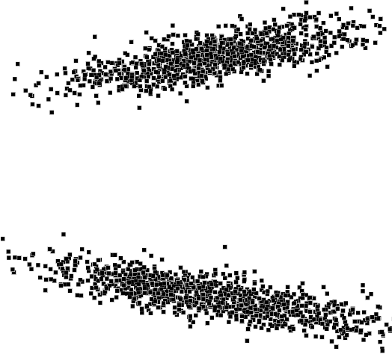
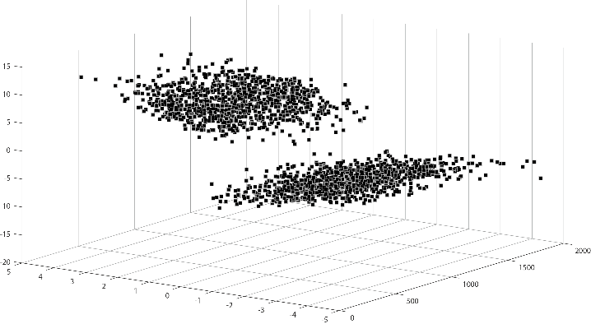
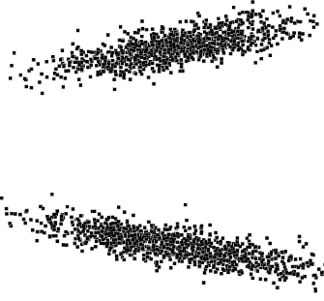
An Example of Prediction for Continuous Labels
Conventional learning
y
y
Learning under Fuzzy logic
time
x
x
The recorded
training data
Problem→Significance→Solution
Notes:
Next, let’s us see the difference between two KNN predictors when they are applied to predict the continuous labels
Given a period of data stream like this, the X and y have linear relationships. It can be seen that the concept is changed from the blue one to the red during this period.
However, when this period of data stream is recorded in the training data, the time label is lost as is shown here. The same X have two corresponding y values.
When we use conventional machine learning methods, it couldn’t build a well-trained model.
By using fuzzy logic, the model is well established when there are several patterns in the training data.

Slide 13
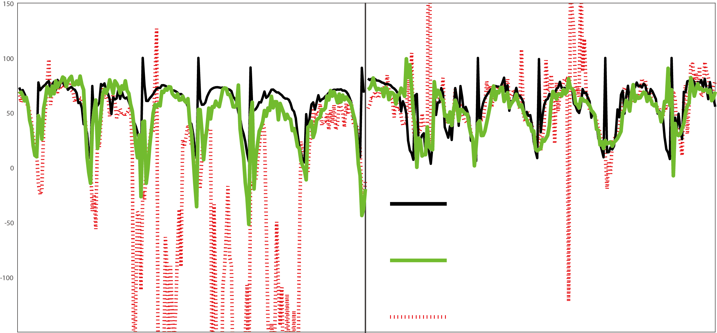
Experimental Results
SMEAR is a 30-miniute-interval weather observation data.
The task is to predict the solar-radiation.
real value
predicted value
with fuzz adaptation
predicted value of machine learning method
Problem→Significance→Solution→Evaluation
Notes:
This is the experimental results on a real-world data stream SMEAR. SMEAR is a set of 30-minute interval environment
observation data collected from the SMEAR II station in Finland. It contains more than 140,000 (140,576) data instances of 43 variables from 15 April 2005 to April 2013.
The task is to predict solar-radiation
This figure shows the prediction result of two periods in the SMEAR data stream. The black line is the real value of these points, the green line is for the prediction of our proposed method, and red dotted line is for the machine learning method without fuzzy logic.
SMEAR contains continuous concept drift that a pattern of repeated increases and decreases shows.
The original machine learning method reacts to this changing concepts slowly and unsteadily.
But our proposed method could handle this drift swiftly.

Slide 14
Experimental Results
Our method compares to other concept drift adaptation methods: using Mean Absolute Error (MAE) as the evaluation metric
 | ORTO | FIMT | metaAMR | AMR | PRE | Our method
MAE | 3.39E+01 | 2.34E+01 | 1.98E+01 | 1.44E+01 | 3.75E+01 | 1.04E+01
Significance test of MAE: Friedman Test and its post-hoc test after Conover (based on five data streams)
Friedman Test | 19.6 | 0.0065**
Friedman- post-hoc test after Conover
Our method to | ORTO | FIMT | metaAMR | AMR | PRE
P-value | <0.01** | 0.007** | 0.0898⁺ | 0.0706⁺ | 0.0051**
Problem→Significance→Solution→Evaluation
Notes:
We also compare our method to other drift adaptation methods. We also successfully beat them.
The significance test is given to verify whether the difference on MAE of these methods is statistical significant. The results shows these difference is statistical significant.

Slide 15
THANK YOU
ANY QUESTIONS?
Yiliao.Song@student.uts.edu.au

